Slide 1
CSC 331: Digital Image Processing
  Color Image Processing
COMSATS University Islamabad, Lahore Campus Digital Image Processing CSD 331

Slide 2
Color Image Fundamentals
Color perception is a psychophysical phenomenon that combines two main components:
  The physical properties of light sources (usually expressed by their spectral power distribution, SPD) and surfaces (e.g., their absorption and reflectance capabilities).
  The physiological and psychological aspects of the human visual system (HVS).
COMSATS University Islamabad, Lahore Campus Digital Image Processing CSD 331

Slide 3
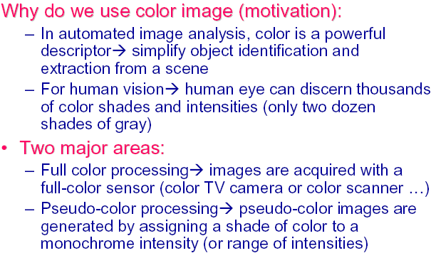
Color Image Fundamentals
COMSATS University Islamabad, Lahore Campus Digital Image Processing CSD 331

Slide 4
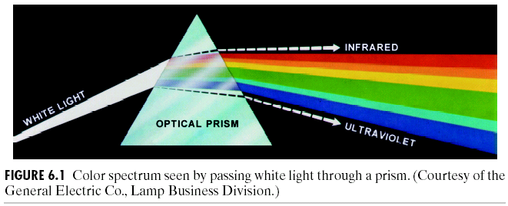
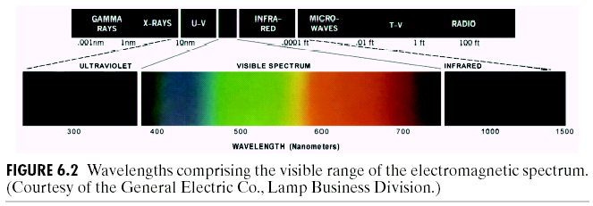
Color Image Fundamentals
COMSATS University Islamabad, Lahore Campus Digital Image Processing CSD 331

Slide 5
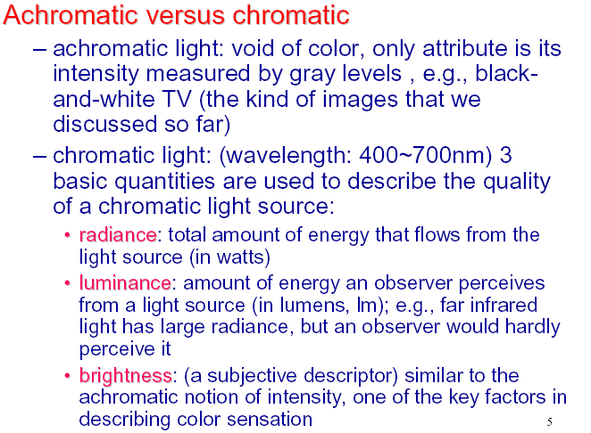
Color Image Fundamentals
COMSATS University Islamabad, Lahore Campus Digital Image Processing CSD 331

Slide 6
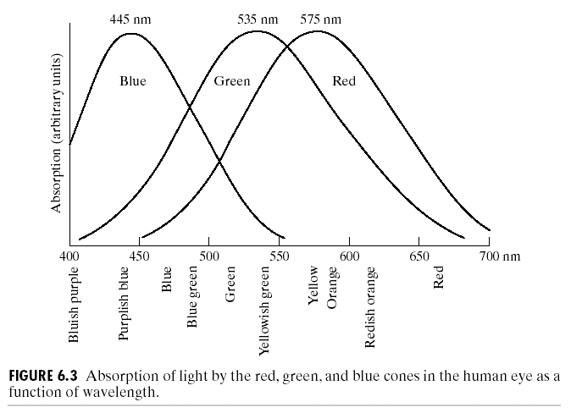
Response of human eye to different colors
COMSATS University Islamabad, Lahore Campus Digital Image Processing CSD 331

Slide 7
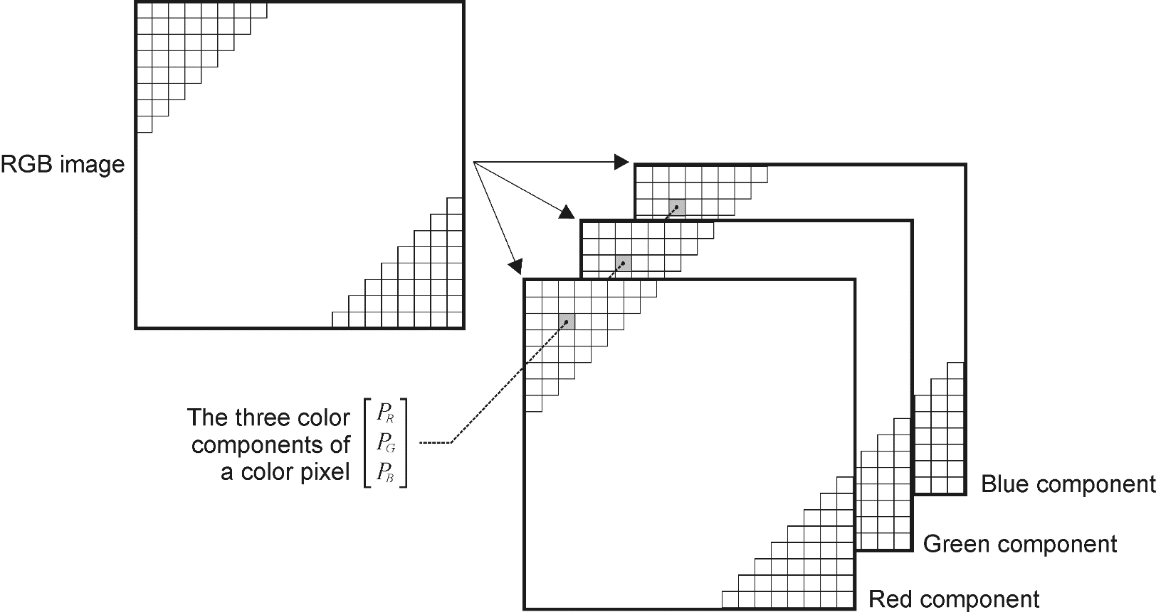
Color Images in MATLAB
  RGB
COMSATS University Islamabad, Lahore Campus Digital Image Processing CSD 331

Slide 8
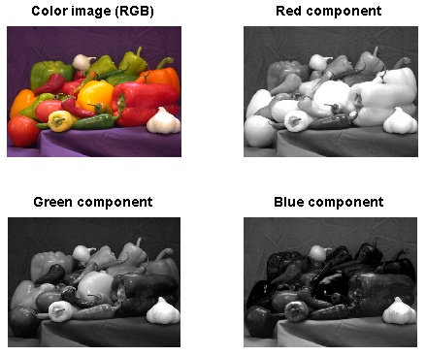
Color Images in MATLAB
I = imread(’peppers.png’);
size(I)
class(I)
subplot(2,2,1), imshow(I), title(’Color image (RGB)’)
subplot(2,2,2), imshow(I(:,:,1)), title(’Red component’)
subplot(2,2,3), imshow(I(:,:,2)), title(’Green component’)
subplot(2,2,4), imshow(I(:,:,3)), title(’Blue component’)
COMSATS University Islamabad, Lahore Campus Digital Image Processing CSD 331

